Slide 1
jQuery
Write less, do more…

Slide 2
Lecture Plan
jQuery – what and why
The ready function
Creating Content
Changing Elements
Applying CSS
Applying functions
Lists of useful JavaScript and jQuery functions
Arrays and Objects in JavaScript

Slide 3
jQuery – What and Why
Write less, do more
jQuery is a JavaScript library
It makes writing JavaScript easier
It smooth out some browser incompatibilities
It is one of the most successful libraries

Slide 4
Preliminaries
<script
src='http://ajax.googleapis.com/ajax/libs/jquery/1.6.1/jquery.min.js'> </script>
You can download the library from google.
This means it may be your user’s cache.
$(document).ready
The ready function takes a function as a parameter.
The function is executed when the page has loaded.
This is a useful time to set up the page

Slide 5
Example
The HTML page – home.html
<!doctype html>
<html>
<head><title>Timetables</title>
<script src='http://ajax.googleapis.com/ajax/libs/jquery/1.6.1/jquery.min.js'> </script>
<script src='hello.js'></script>
</head>
<body>
<div id='container'>
…
The JavaScript page – hello.js
// hello.js
$(document).ready(function(){
alert("Hello world");
});

Slide 6
The Anonymous Function
This statement:
Creates a function.
Sends that function to the ready function.
The Anonymous Function will execute when the page is ready.
$(document).ready(
function(){
alert("Hello world");
}
);

Slide 7
Creating Content
You can create content using the $ function.
You can add the content to your page using the append method.
$(document).ready(function(){
var msg = $('<div>Hello World</div>');
$('body').append(msg);
});

Slide 8
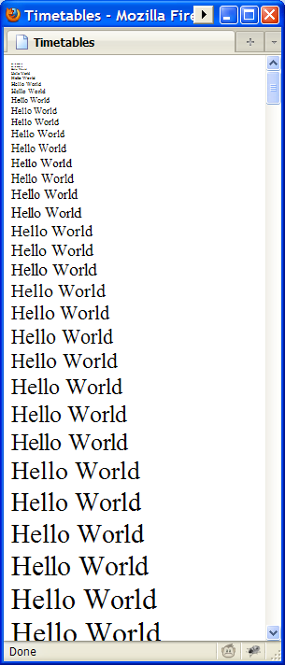
Creating Content and Changing it
After you create a node you can change it:
$(document).ready(function(){
for (var i=0;i<100;i++){
var msg = $('<div>Hello World</div>');
msg.css('font-size',i);
$('body').append(msg);
}
});

Slide 9
Creating structured elements
You can create elements that contain elements.
Examples
A <ul> element should contains <li> elements
A <table> element should contain <tr> elements
The <tr> elements should contain <td> elements

Slide 10
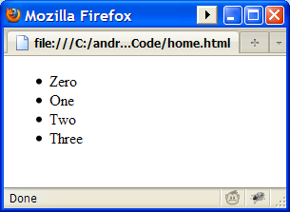
Create a <ul> list
$(document).ready(function(){
var lst = ["Zero", "One", "Two", "Three"];
var ul = $('<ul/>');
for (var i=0;i<lst.length;i++){
var li = $('<li/>');
li.html(lst[i]);
ul.append(li);
}
$('body').append(ul);
});

Slide 11
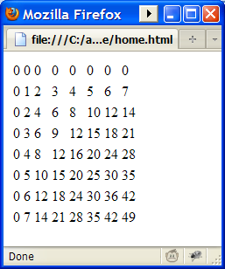
Create a table with rows and cells
$(document).ready(function(){
var table=$('<table/>');
for (var i=0;i<8;i++){
var tr= $('<tr/>');
for (var j=0;j<8;j++){
var td=$('<td/>');
td.html(i*j);
tr.append(td);
}
table.append(tr);
}
$('body').append(table);
});

Slide 12
Some Useful jQuery functions
html
You can use the html method to change the content of an element
append
The append function adds to the end of an element
prepend
The prepend function adds to the beginning of an element
css
The function css is used to set a css property of an element

